Slide 1
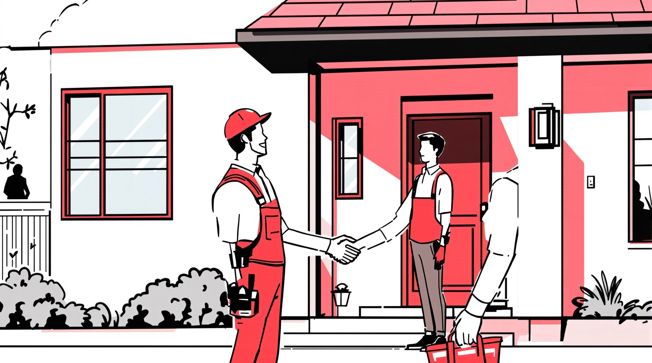
A Complete Step-by-Step Guide to theRoofing Insurance Claim Process
ROOF INSURANCE EXPERTS!
WE'LL HELP WIN YOUR CLAIMOR WE'LL WORK FOR FREE!
UNDERSTANDING YOUR CONTINGENCY AGREEMENT
David Saitta
LAND Roofing Company
Florida State Certified Roofing LIC# CCC1326379
"IN BUSINESS SINCE 1937"
904-891-8435

Slide 2
PHASE 1: INITIAL ASSESSMENT
A
INITIAL CONSULTATION
4+ hours minimum with homeowner including first meeting, phone calls, and check collection
David Saitta | 904-891-8435 | LAND Roofing Company

Slide 3
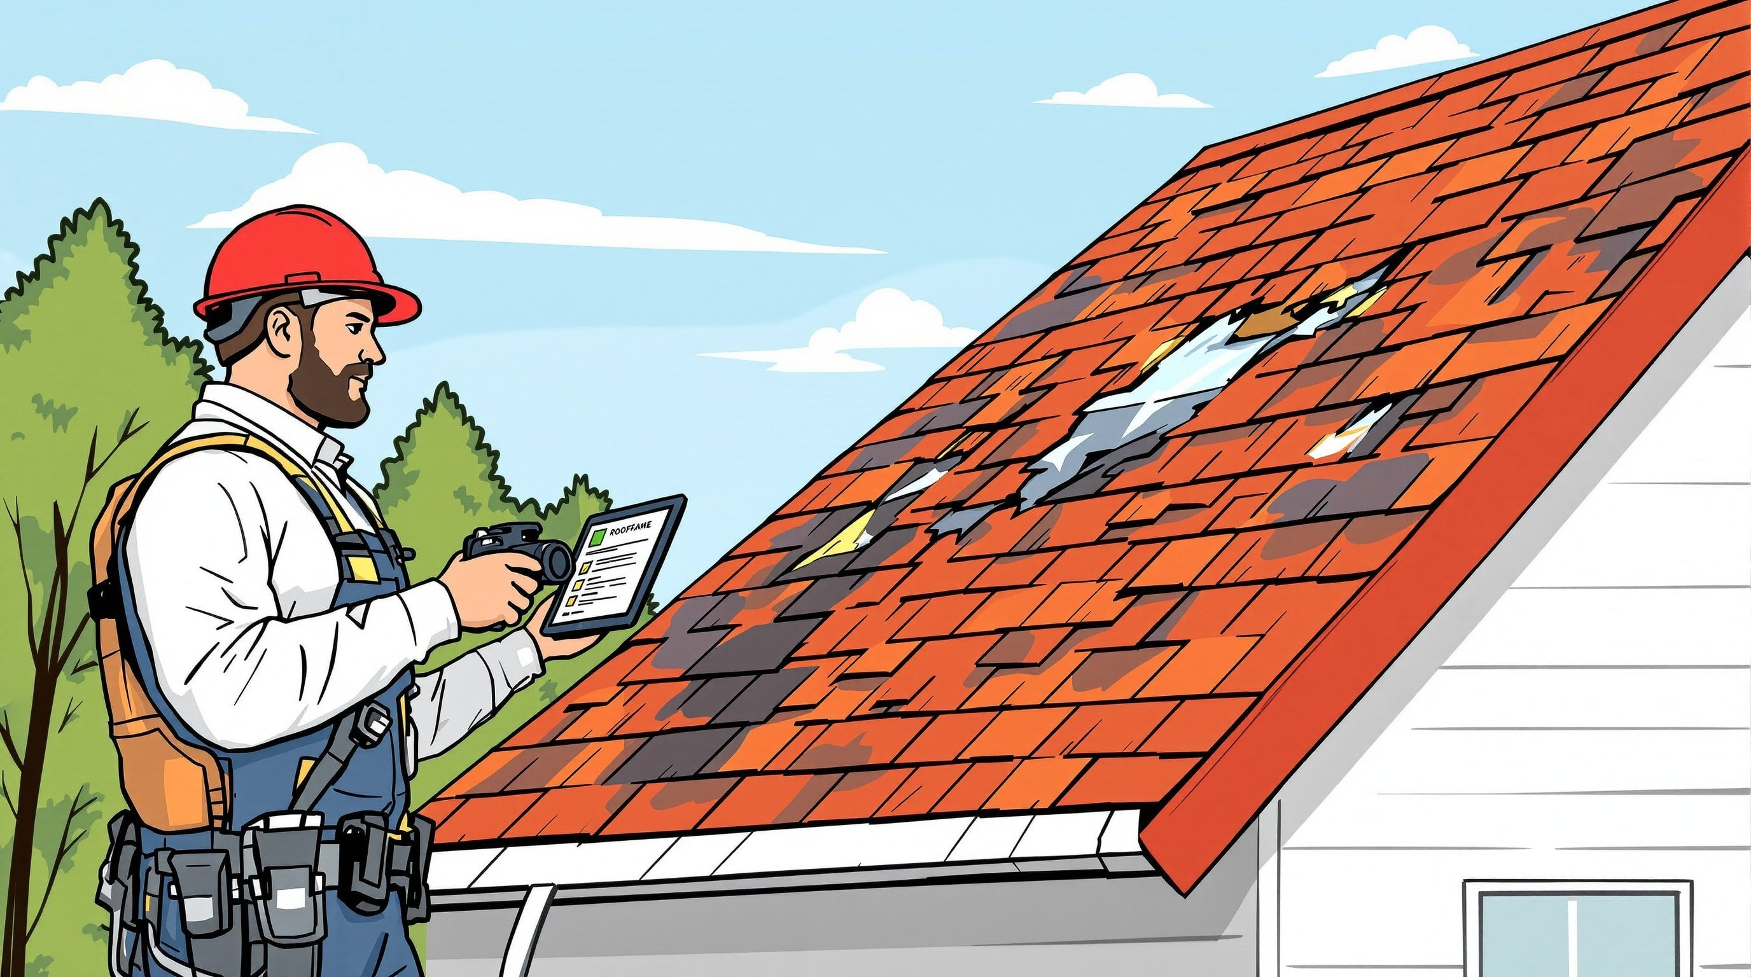
PHASE 1: INITIAL ASSESSMENT
B
COMPLETE DAMAGE ASSESSMENT
Comprehensive damage assessment with detailed notes, photos, and videos all pushed to the cloud
David Saitta | 904-891-8435 | LAND Roofing Company

Slide 4
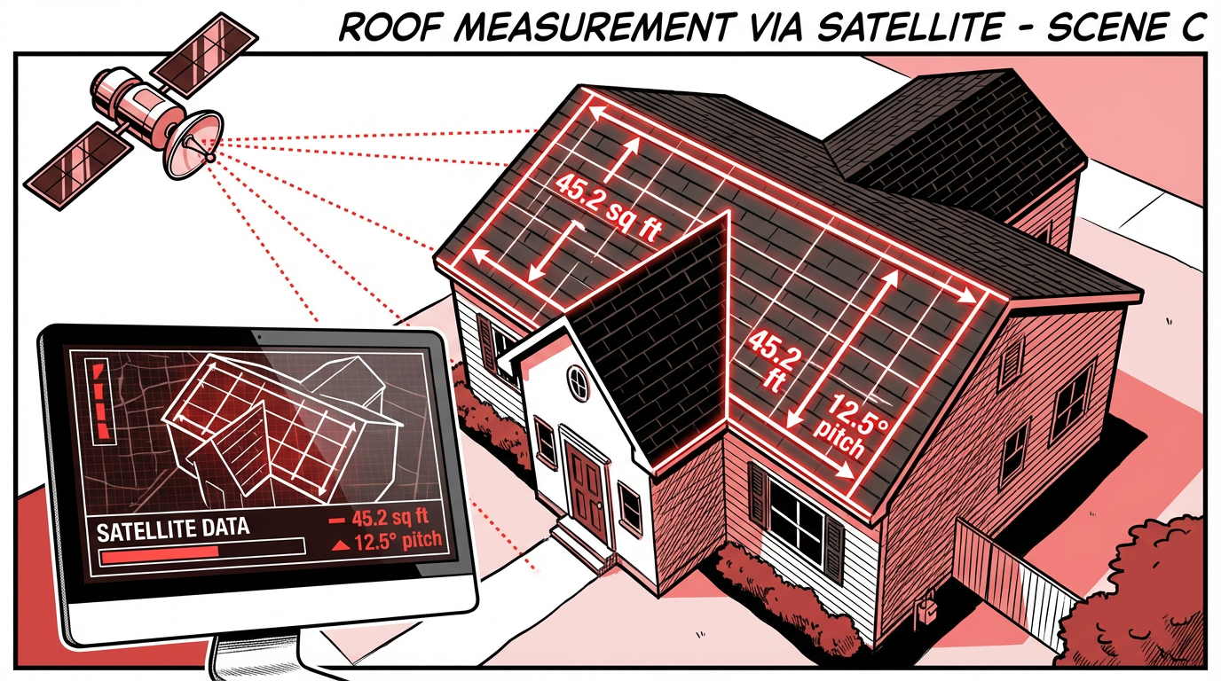
PHASE 1: INITIAL ASSESSMENT
C
ROOF MEASUREMENT
Purchase a RoofR satellite measurement for accurate roofing work estimation
David Saitta | 904-891-8435 | LAND Roofing Company

Slide 5
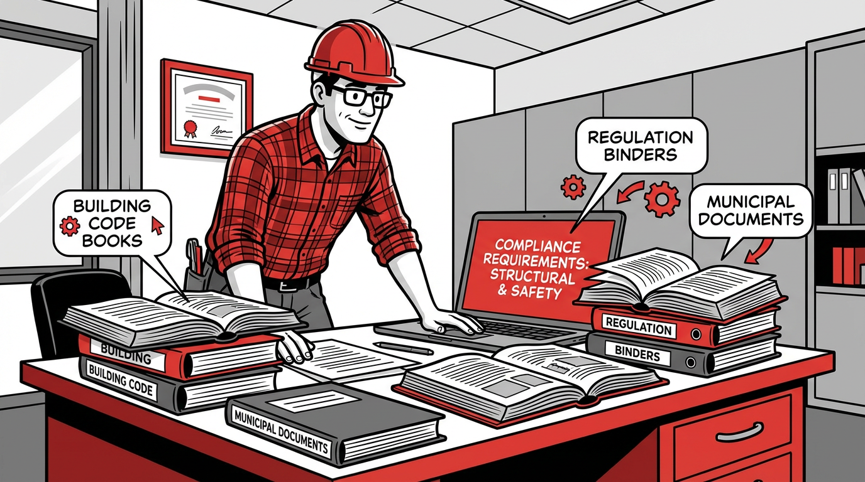
PHASE 2: DOCUMENTATION & ESTIMATES
D
GOOD-FAITH ESTIMATE
Create detailed estimate based on Xactimate software for each damaged area
David Saitta | 904-891-8435 | LAND Roofing Company

Slide 6
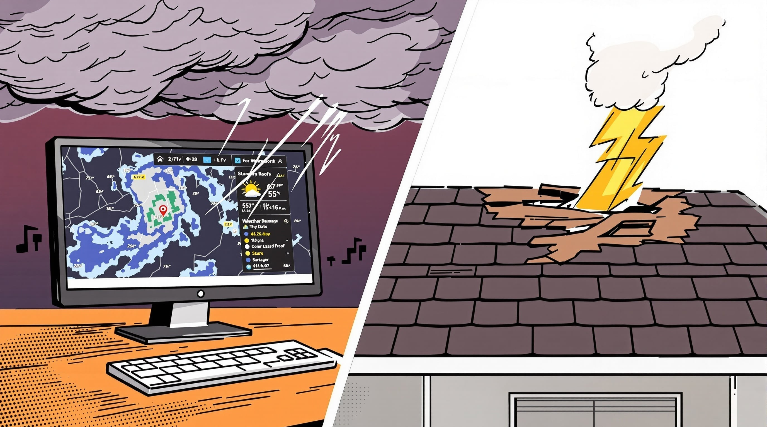
PHASE 2: DOCUMENTATION & ESTIMATES
E
WEATHER VERIFICATION
Confirm weather in area matches damages to ensure a valid storm claim exists
David Saitta | 904-891-8435 | LAND Roofing Company

Slide 7
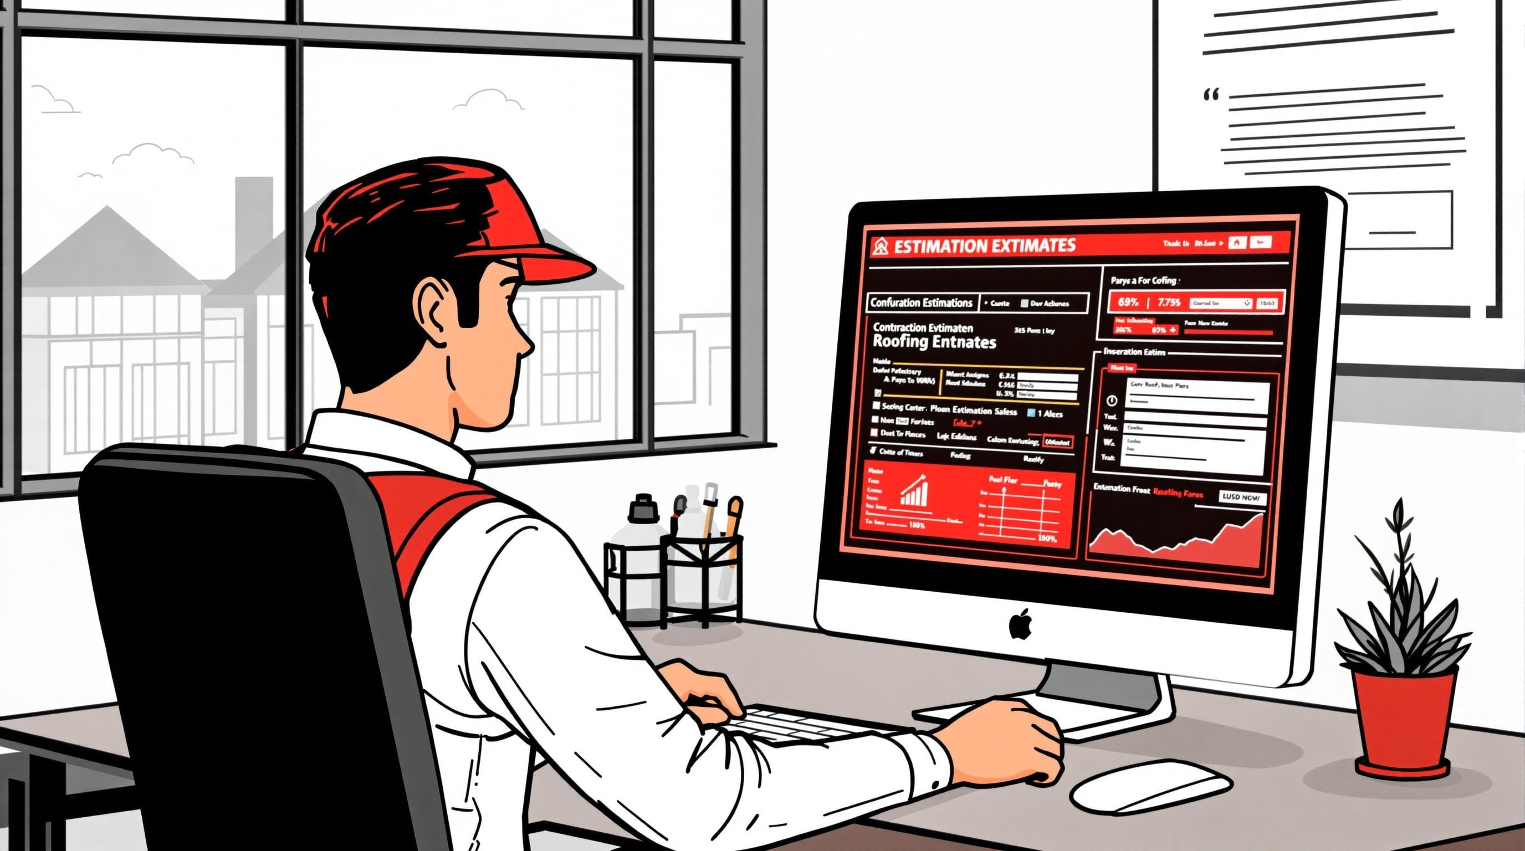
PHASE 2: DOCUMENTATION & ESTIMATES
F
BUILDING CODES RESEARCH
Research and list building codes for each area of damage vs. home or property needs
David Saitta | 904-891-8435 | LAND Roofing Company

Slide 8
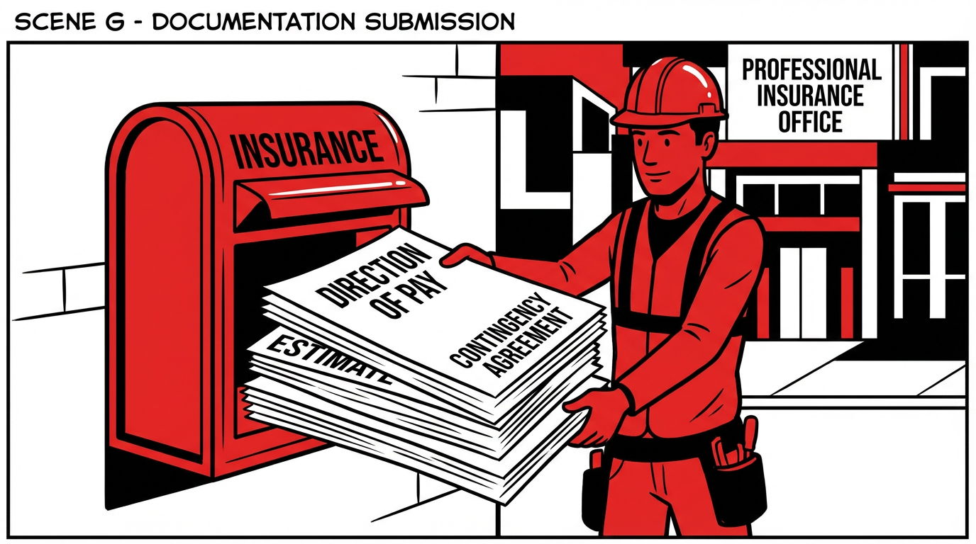
PHASE 3: INSURANCE SUBMISSION
G
DOCUMENTATION SUBMISSION
Submit direction of pay, contingency agreement, good-faith estimate, and company licensing to insurance carrier
David Saitta | 904-891-8435 | LAND Roofing Company

Slide 9
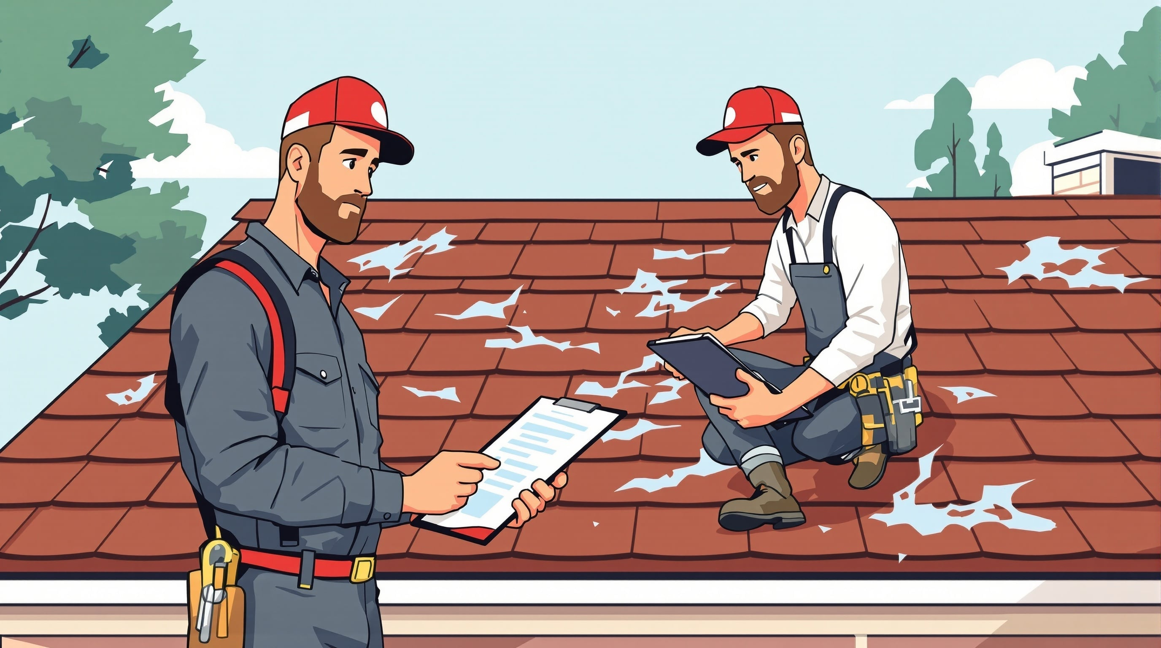
PHASE 3: INSURANCE SUBMISSION
H
MEET FIELD ADJUSTER
Meet carrier's field adjuster on roof to review damages. May include second adjuster or engineer consultation
David Saitta | 904-891-8435 | LAND Roofing Company

Slide 10

PHASE 4: INSURANCE FOLLOW-UP
I
INSURANCE FOLLOW-UP
Average 18 calls per claim
Persistent follow-up with carrier to get first ACV check sent
David Saitta | 904-891-8435 | LAND Roofing Company

Slide 11

PHASE 5: FINANCIAL COLLECTION
J
COLLECT FUNDS & CONFIRM COLORS
Meet with homeowner to collect cleared funds from mortgage/bank and confirm color selections
David Saitta | 904-891-8435 | LAND Roofing Company

Slide 12

PHASE 6: PERMITS & MATERIALS
K
NOTICE OF COMMENCEMENT
Collect signed Notice of Commencement (N.O.C.) to file building permit at homeowner's address
David Saitta | 904-891-8435 | LAND Roofing Company

Slide 13
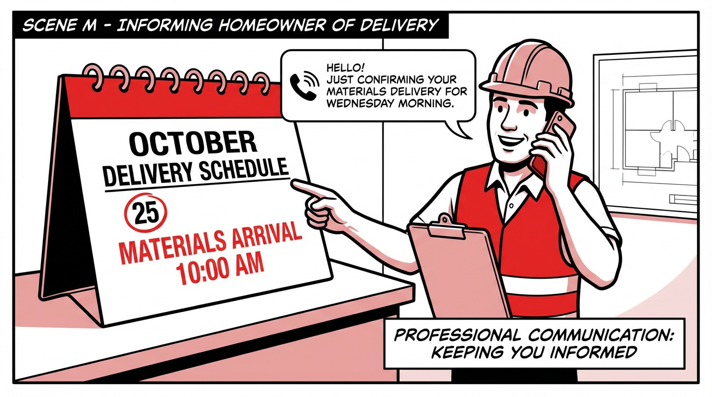
PHASE 6: PERMITS & MATERIALS
L
ORDER MATERIALS
Create/order material list, schedule labor, and pay for products/materials to start repairs
David Saitta | 904-891-8435 | LAND Roofing Company

Slide 14

PHASE 6: PERMITS & MATERIALS
M
SCHEDULE DELIVERY
Inform homeowner of materials drop on roof/driveway and confirm labor schedule
David Saitta | 904-891-8435 | LAND Roofing Company

Slide 15
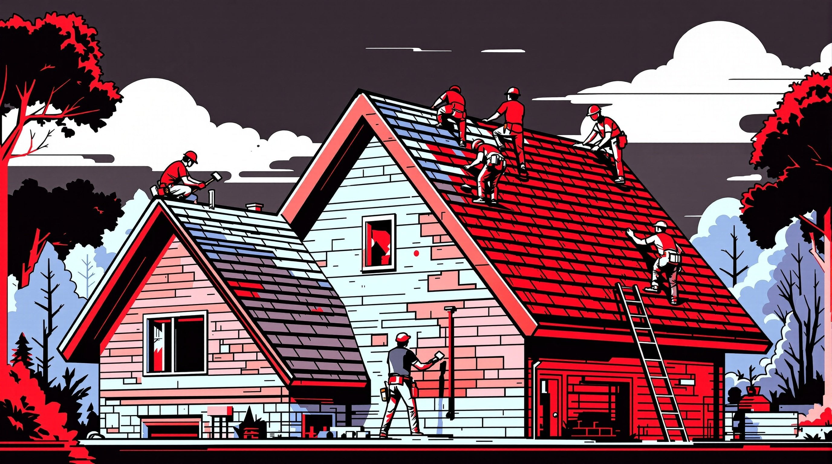
PHASE 7: CONSTRUCTION
N
RE-ROOFING WORK
Re-roofing takes place while documenting all extra damages found. ACV deposit minimum required
David Saitta | 904-891-8435 | LAND Roofing Company

Slide 16
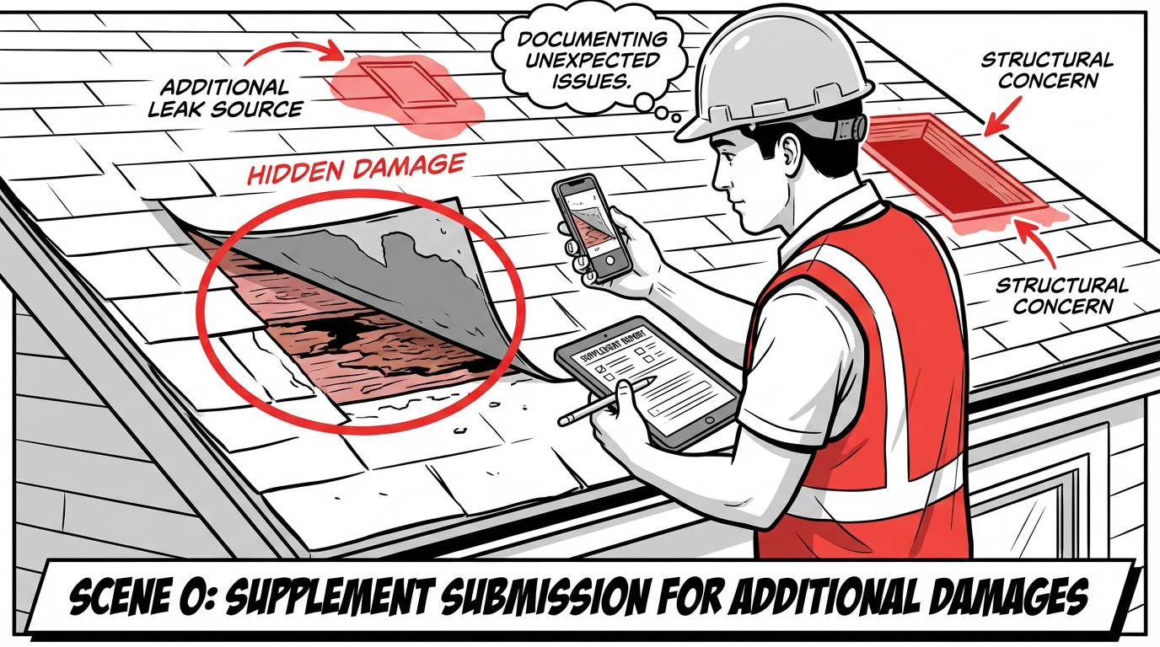
PHASE 7: CONSTRUCTION
O
SUPPLEMENT SUBMISSION
If additional damages found, create supplement to submit to carrier for additional payment
David Saitta | 904-891-8435 | LAND Roofing Company

Slide 17
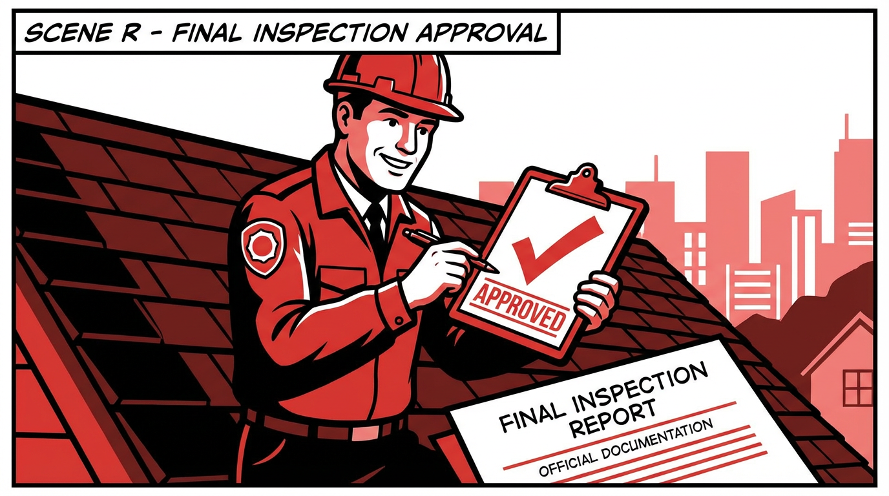
PHASE 8: INSPECTIONS & PAYMENT
P
DRY-IN INSPECTION
Schedule and coordinate roofing dry-in inspections with city/county building department
David Saitta | 904-891-8435 | LAND Roofing Company

Slide 18

PHASE 8: INSPECTIONS & PAYMENT
Q
COLLECT FINAL PAYMENT
Remaining 50% balance
Collect remaining 50% balance immediately after work completion from homeowner
David Saitta | 904-891-8435 | LAND Roofing Company

Slide 19

PHASE 8: INSPECTIONS & PAYMENT
R
FINAL INSPECTION
Schedule and coordinate final inspections with city/county building department
David Saitta | 904-891-8435 | LAND Roofing Company

Slide 20
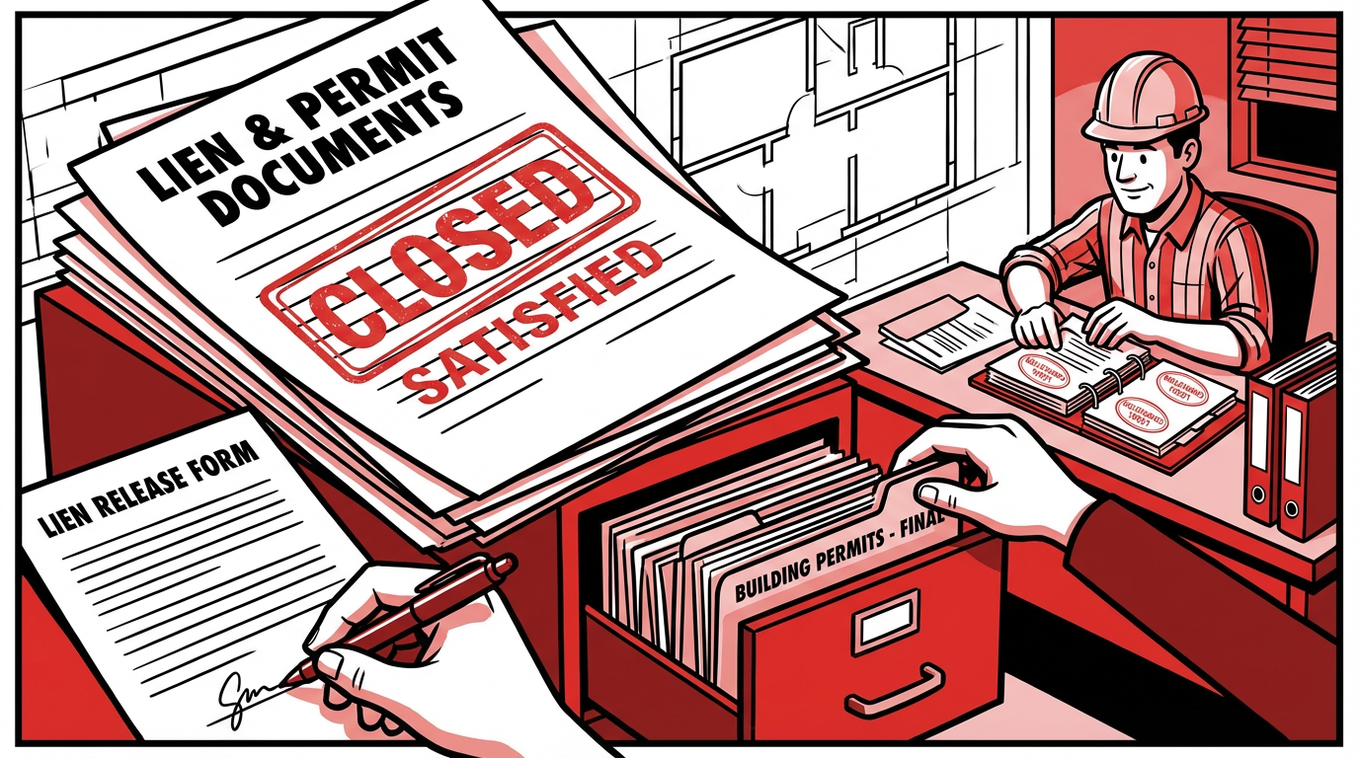
PHASE 9: PROJECT COMPLETION
S
COMPLETION DOCUMENTATION
Submit new roof completion/install photos to insurance carrier proving completion
David Saitta | 904-891-8435 | LAND Roofing Company

Slide 21
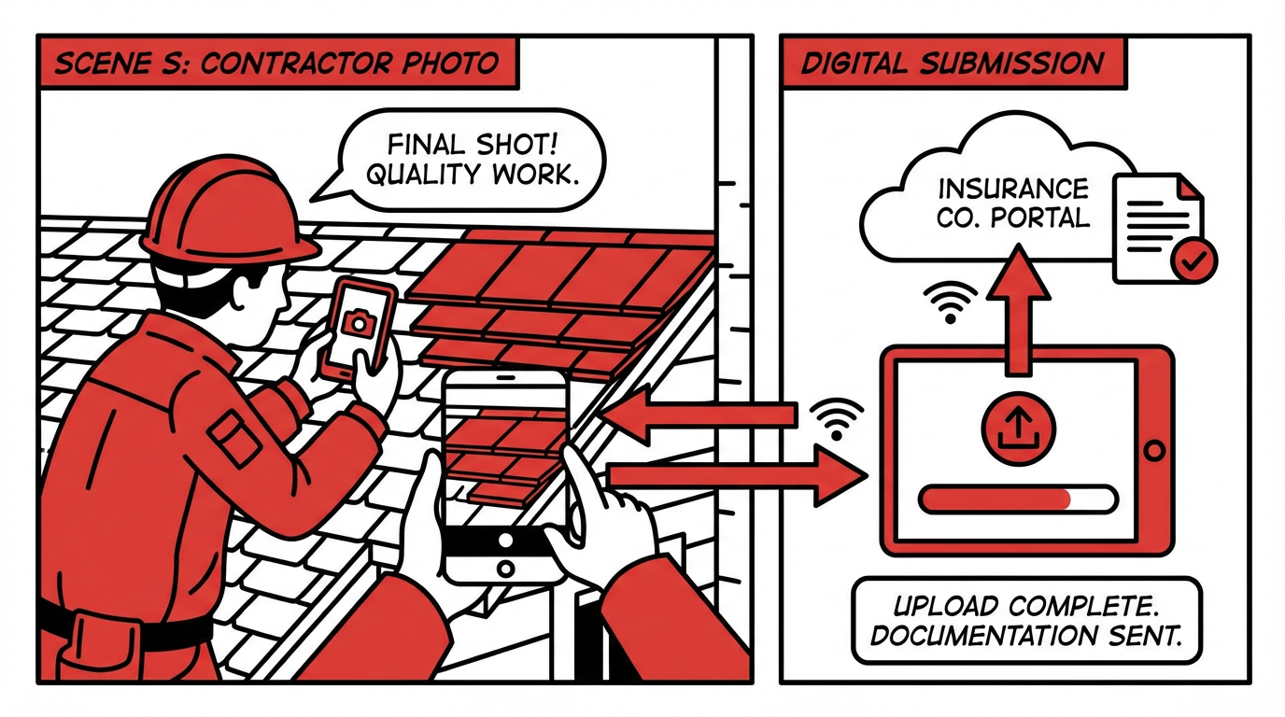
PHASE 9: PROJECT COMPLETION
T
WARRANTY REGISTRATION
Register new roof with chosen manufacturer for extended warranty coverage
David Saitta | 904-891-8435 | LAND Roofing Company

Slide 22
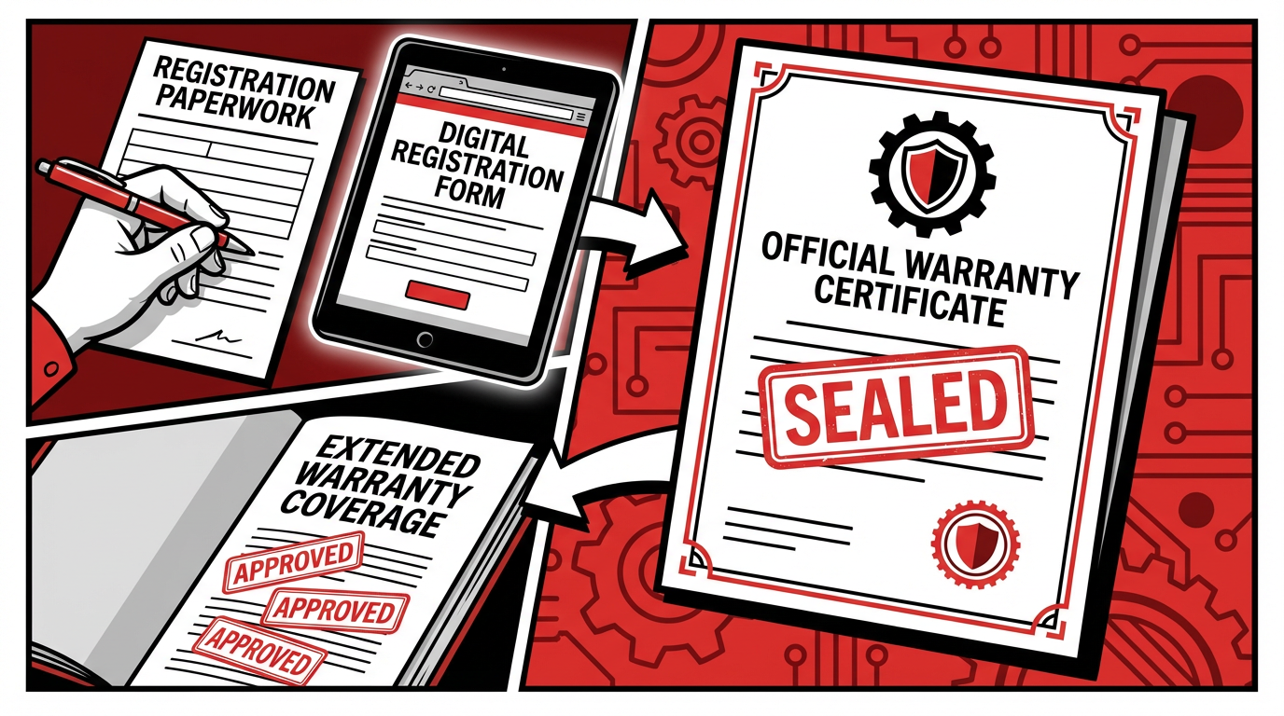
PHASE 9: PROJECT COMPLETION
U
LIEN & PERMIT CLOSEOUT
Help closing out/removing/satisfying any sub-contractor notices, liens, permits, insurance requests
David Saitta | 904-891-8435 | LAND Roofing Company

Slide 23
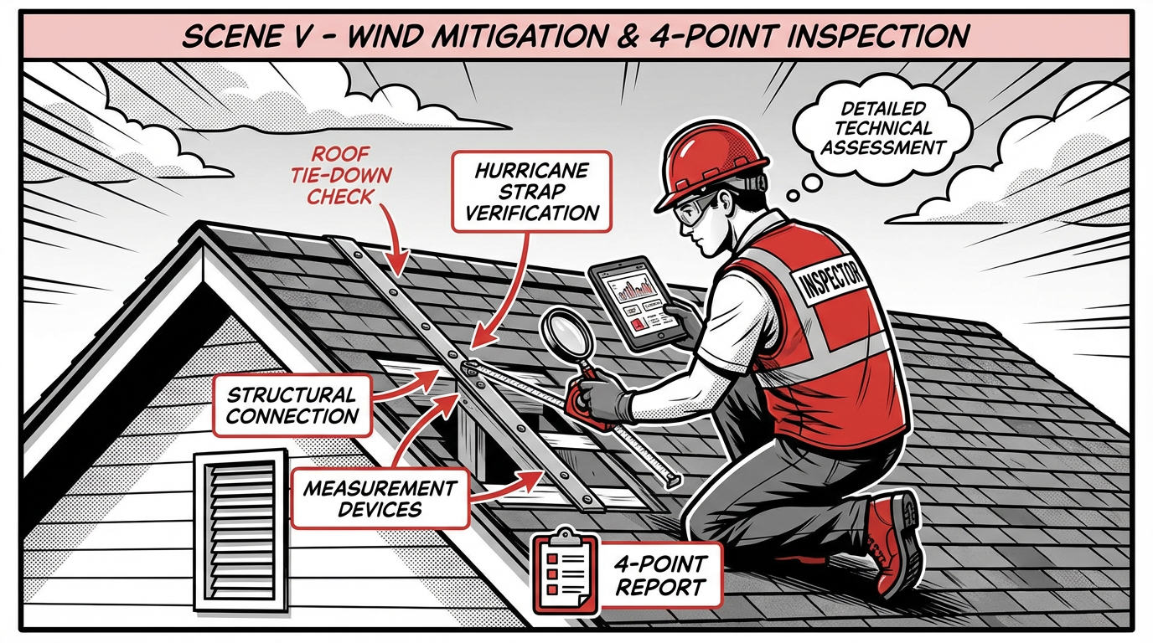
PHASE 9: PROJECT COMPLETION
V
COORDINATE INSPECTIONS
Coordinate any wind mitigation or 4-point inspections promised or sold separately
David Saitta | 904-891-8435 | LAND Roofing Company

Slide 24
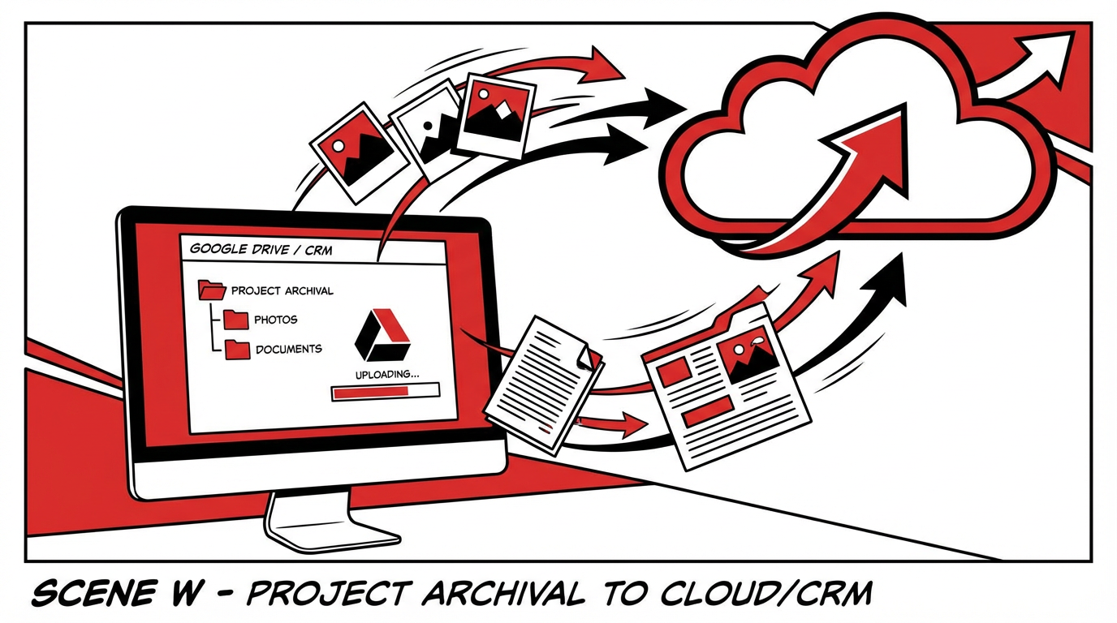
PHASE 9: PROJECT COMPLETION
W
PROJECT ARCHIVAL
Close out project and upload all documentation to Google Drive/CRM and send to insurance carrier
David Saitta | 904-891-8435 | LAND Roofing Company

Slide 25





IMPORTANT NOTES
Please Read Carefully
CONTRACTOR PAYMENT
RARE CASE — WAITING ON INSURANCE
Your contractor is not your bank — they do not 'wait' to be paid. They can help facilitate the process but cannot negotiate or sue your insurance carrier. Only you, a P.A., or lawyer can.
If contractor waits on insurance proceeds (no financing), contractor is 100% entitled to recoverable depreciation checks, supplement checks, 1st ACV check, and your deductible.
N.T.O.'S / PRE-LIENS (FL STATUTES 713 PT1)
DEDUCTIBLES — FLORIDA LAW
Sub-contractors or suppliers may send a Notice to Owner (N.T.O.) to secure payment and lien rights. A contractor may lien the customer's home to recover unpaid construction costs.
Any contractor performing insurance-based work that doesn't collect the homeowner's deductible could be charged with a FELONY in Florida. Deductible collection is mandatory.
David Saitta | 904-891-8435 | LAND Roofing Company

